Slide 1
ABDA: Assignment 7
2020-01-21

Slide 2
Model structure
transformed data {
vector[N_data] log_reaction_time = log(reaction_time);
}
parameters {
// Group level
vector[2] mu;
vector<lower = 0>[2] tau;
vector[2] phi;
// Individual level
vector[N_subjects] theta[2];
real<lower = 0> sigma;
}
model {
for (i in 1:N_data) {
log_reaction_time[i] ~ normal(theta[1][subjects[i]] + theta[2][subjects[i]] * attempts[i] , sigma);
}
for (i in 1:N_subjects) {
theta[1][i] ~ normal(mu[1] + phi[1]*is_child[i], tau[1]);
theta[2][i] ~ normal(mu[2] + phi[2]*is_child[i], tau[2]);
}
}

Slide 3
Question 1: Give an interpretation of theta0 and theta1 in plain text. Explain to a non-statistician what these two parameters mean.
In standard scale:
theta0 is the mean estimate for the starting reaction time for each individual
theta1 is the mean estimate for the learning rate/attempt

Slide 4
Question 2: Give an interpretation of all the phi:s and mu:s in plain text. Explain to a non-statistician what these parameters mean. Try to do it in the original scale, i.e. in terms of average reaction time rather than log reaction time.
mu0 is the starting reaction time mean estimate for an adult
phi0 is the difference in starting reaction time mean estimate between a child and an adult
mu1 is the learning rate mean estimate for an adult
phi1 is the difference in learning rate mean estimate between a child and an adult

Slide 5
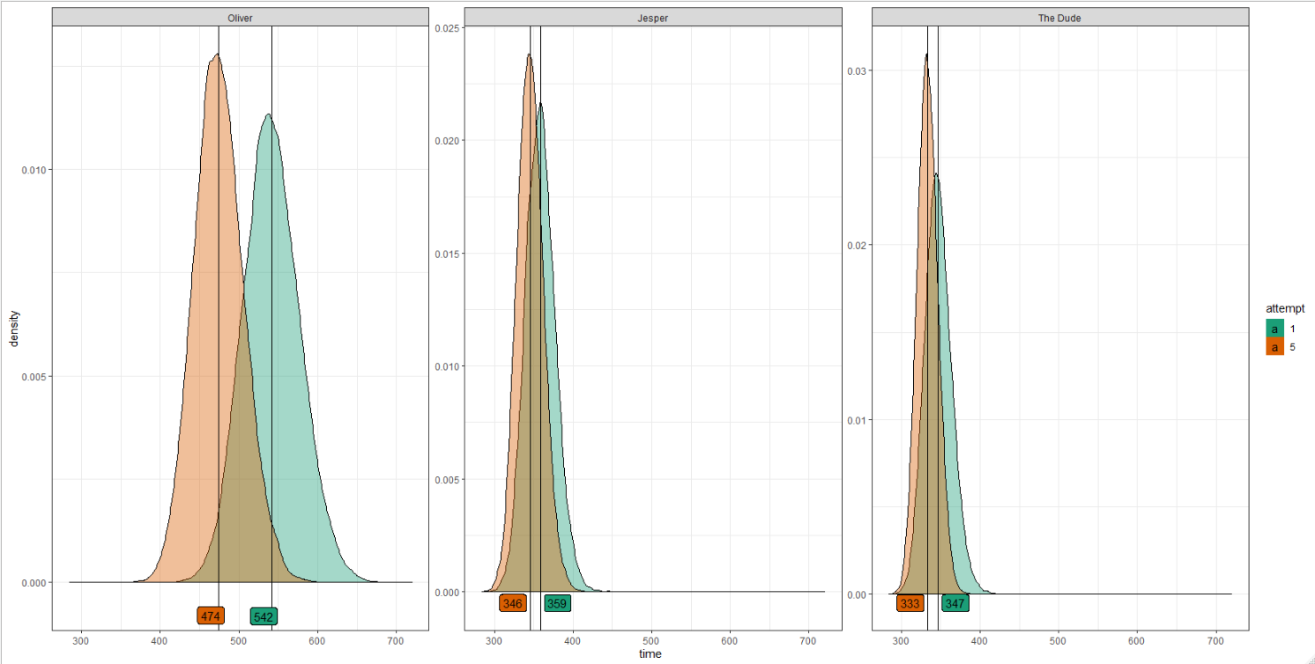
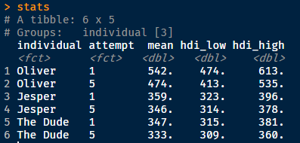
Question 3: Provide the expected reaction time for the first attempt (x=1) and the fifth attempt (x=5) for the first individual (Oliver), third individual (Jesper) and fourth individual (“the dude”), i.e. individuals j = 0,2,3 in python or j=1,3,4 in julia/matlab. See my (soon to come) results below if you get similar results.

Slide 6
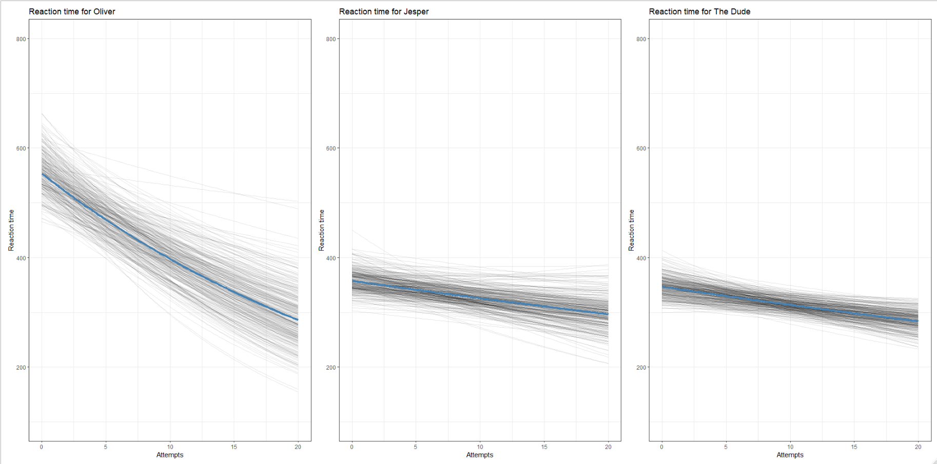
Question 3: Also, if you have time, plot (a subset of) credible regression lines for these 3 individuals and their measurements of reaction time in the same figure. See my results below.

Slide 7
Question 4: Discuss possible model improvements to our model.
What would happen if x goes to infinity? Is this physically realistic? It seems like there is no way to get a reaction time less than 100ms looking at the website and our data.
How can we improve the model?
Should we change distributions (likelihood, priors)? What options do we have and why?
The expected reaction time with infinite attempts would be 0, which is not realistic.
Naïve improvement would be to model a plateau such that in the model
log_reaction time goes to log(100) as x goes to Inf

Slide 8
Question 5: Notice that your sigma has decreased in Assignment 7, but are the same in 6 and 5. Why is that do you think?
Sigma is smaller due to that some of the variation from assignment 5 and 6 are explained in theta1

Slide 9
Question 6: When reporting your findings, you may follow section 25.1 on how to report Bayesian analysis using MCMC. However, this too cumbersome to for this Assignment. My suggestion is that you read section 25.1 and create the same bullet list as Kruschke has. In your bullet list, explain what you have not done according to Kruschke and similarly what you have done
Motivations:
Data structure, model and parameters: Data is reaction times (n = 316) for a varying number of attempts (1-20) for a total of 34 individuals distributed across children (n = 6) and adults (n = 28). Reaction time is modelled as a hierarchical linear model in log-space with parameters starting reaction time and a learning rate. Both of these parameters are in turn modelled as linear model with a delta added if the person was a child. Each hierarchical level has a variance parameter associated with it, for a total of 3 variance parameters.
Describe and justify priors: Prior on starting reaction time and learning rate in log-space have normal priors, with a unform prior for the standard deviation. The hyperparameters on starting reaction time and learning rate have a uniform distribution, as well as the standard deviation for these. The goal was continuous parameter estimation and as such vague normal priors with uniform hyperparameters were used.

Slide 10
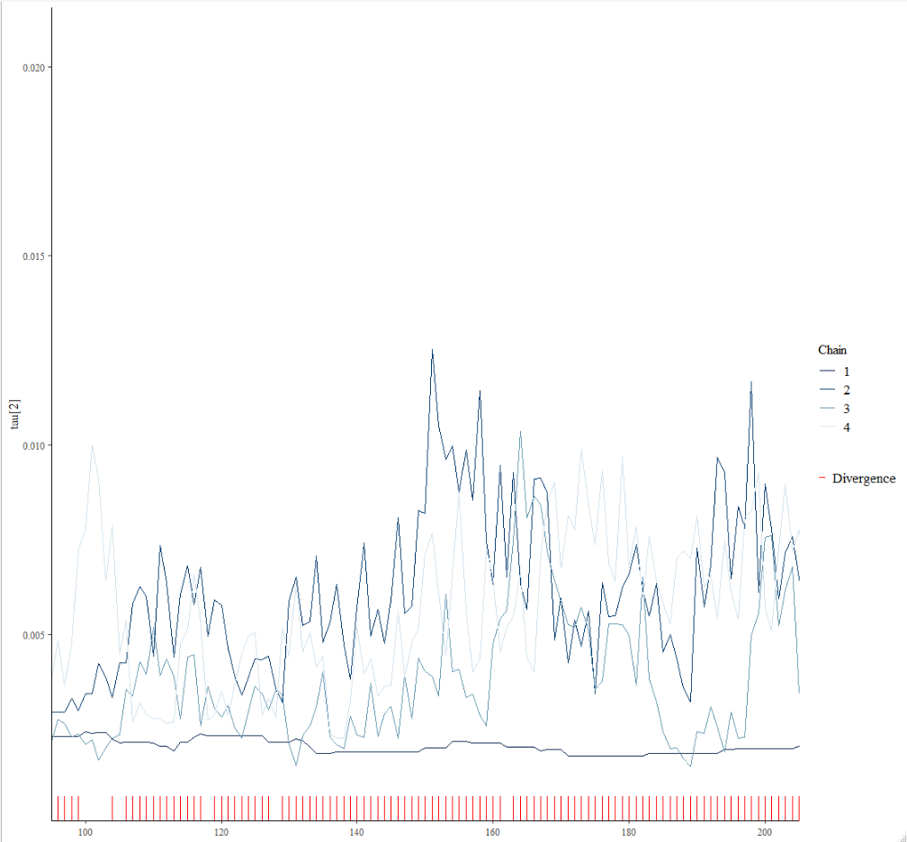
Question 6: When reporting your findings, you may follow section 25.1 on how to report Bayesian analysis using MCMC. However, this too cumbersome to for this Assignment. My suggestion is that you read section 25.1 and create the same bullet list as Kruschke has. In your bullet list, explain what you have not done according to Kruschke and similarly what you have done
MCMC details: Divergence occurred in the chains. Low effective sample size due to one chain getting stuck for long periods. Problematic parameters seem to be primarily in tau1 when it goes close to 0.

Slide 11
Question 6: When reporting your findings, you may follow section 25.1 on how to report Bayesian analysis using MCMC. However, this too cumbersome to for this Assignment. My suggestion is that you read section 25.1 and create the same bullet list as Kruschke has. In your bullet list, explain what you have not done according to Kruschke and similarly what you have done
Interpretation:
Adults seem initially to have faster reaction times than the children. However the learning rate for the children is larger than for adults.

